Slide 1
Statistical and Predictive Modeling II (DATA 2204) Professor: Fatma Tetikoglu Submitted By: Yash Gangaram Dahibhate Student No.: 100947985 Date: 08/12/2024
Final Project

Slide 2
Problem Statement
Mr. John Hughes has been analyzing the wireless_churn.csv dataset and has requested the development of three forecasting models to predict customer churn. The dataset contains 3,333 observations and 11 variables, including account activity, customer service interactions, and usage patterns. The goal is to build models using Logistic Regression, Naïve Bayes, and a Voting Ensemble to accurately classify whether a customer will cancel the service (Churn = 1) or not (Churn = 0).

Slide 3



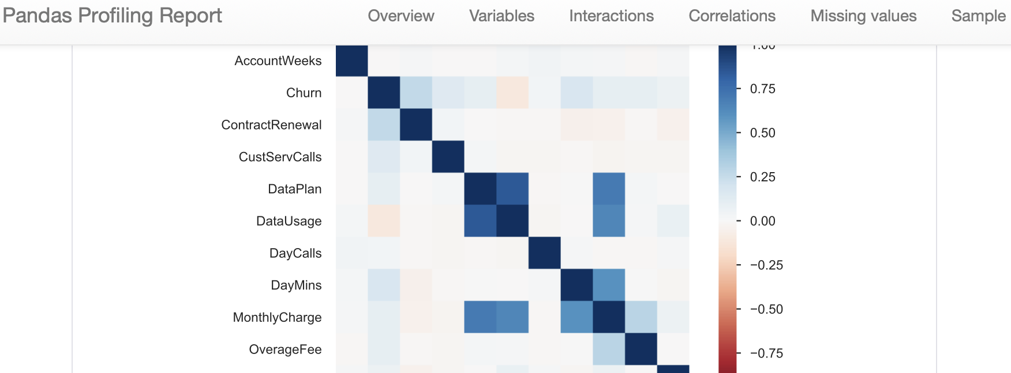
Insight 1: Strong Correlation Between Data Plan and Data Usage
Key Observation:
The Data Plan and Data Usage variables are highly correlated, with a correlation coefficient of 0.841.
Implication:
Customers with a data plan tend to use more data. This could indicate that offering or promoting data plans may increase customer satisfaction and reduce churn.

Slide 4
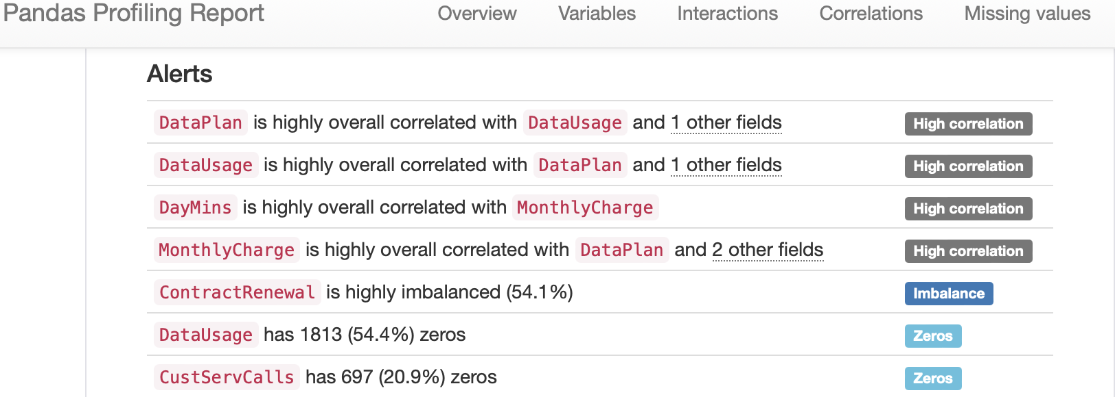
Insight 2: Imbalance in Contract Renewal
Key Observation:
The Contract Renewal variable is highly imbalanced, with 54.1% of customers recently renewing their contracts.
Implication:
This imbalance suggests that the likelihood of churn may be significantly affected by whether a customer has recently renewed their contract, which could be an important feature in predicting churn.

Slide 5
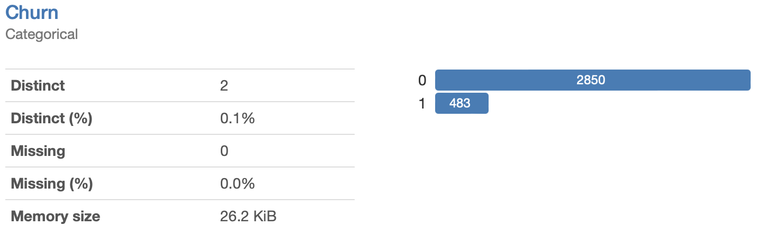
Insight 3: Insight: Imbalance in Churn Distribution
Key Observation:
The target variable, Churn, is highly imbalanced with 85.5% of customers not churning (0) and only 14.5% churning (1).
Implication:
This significant class imbalance may lead to biased model predictions, where the model might predict the majority class (non-churn) more frequently. Special techniques such as resampling, adjusting class weights, or using specific evaluation metrics like AUC-ROC might be necessary to address this imbalance and improve model performance.

Slide 6
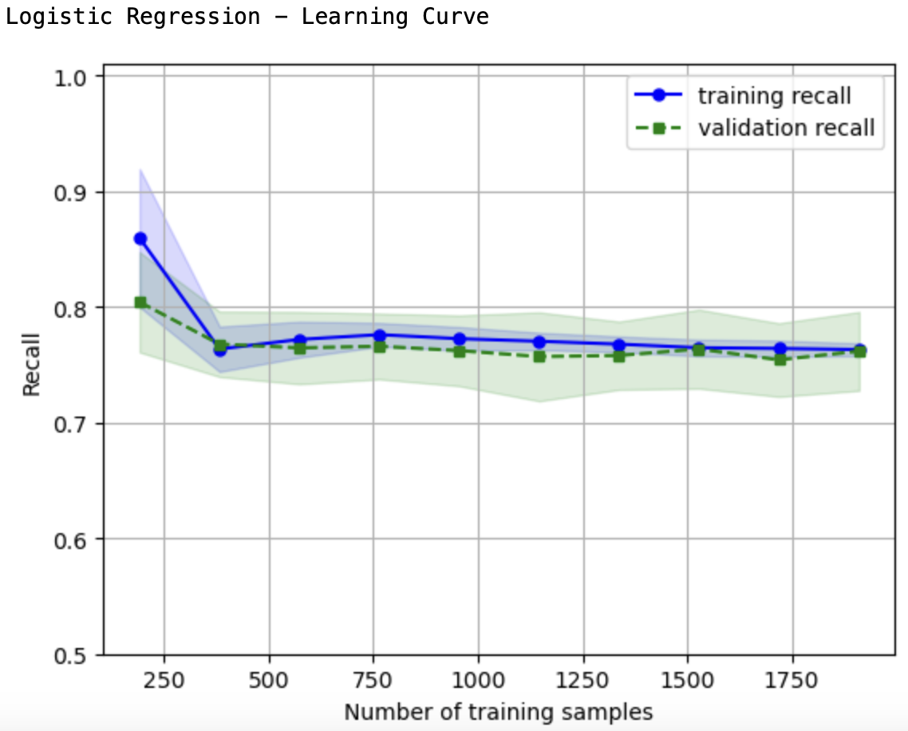
Logistic Regression – Learning Curve
Initial High Recall with Overfitting: The training recall starts very high but drops sharply as more training samples are added, indicating initial overfitting. However, it stabilizes as the model is trained with more data, leading to better generalization.
Convergence of Recall Scores: Both training and validation recall curves converge as the number of training samples increases, showing that the model can generalize well across different sets of data without significant overfitting or underfitting.

Slide 7
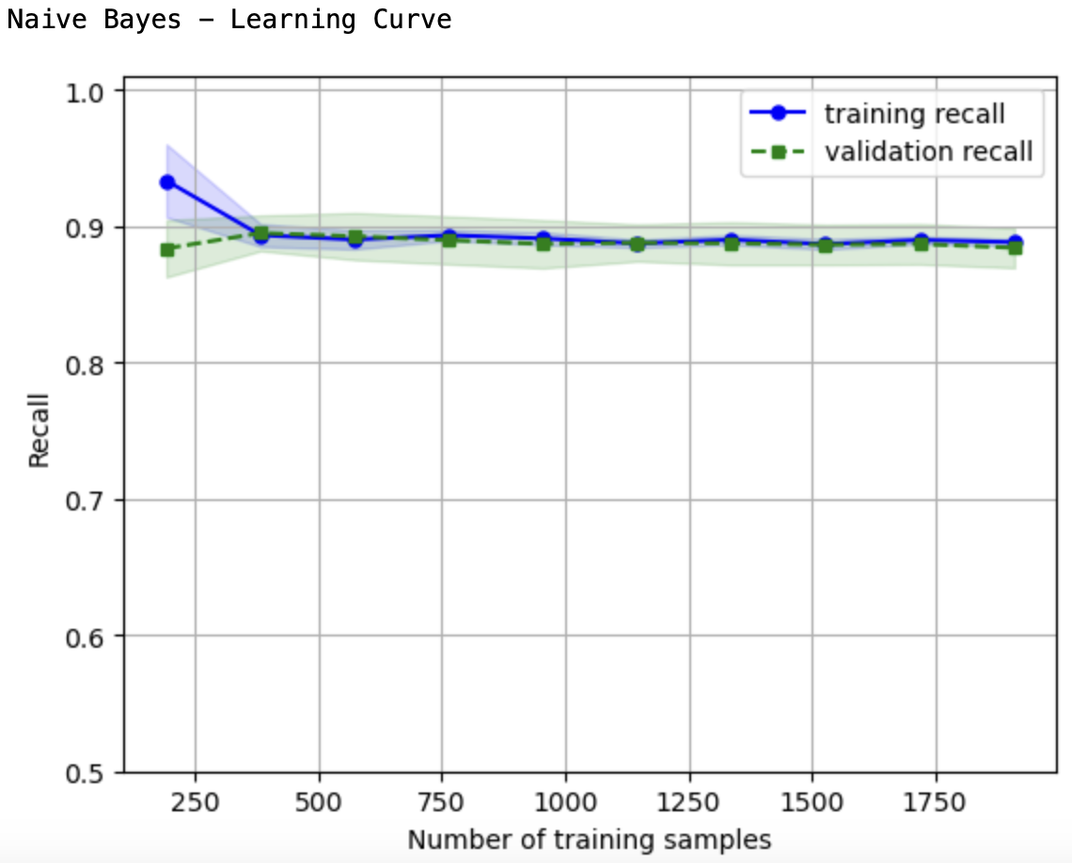
Naïve Bayes – Learning Curve
Consistently High Recall: The Naïve Bayes model shows consistently high recall for both training and validation sets, indicating that the model is robust and performs well across different data splits.
Stable Performance Across Data Samples: Unlike the Logistic Regression model, the recall for Naïve Bayes does not fluctuate much with increasing data, suggesting that this model is less sensitive to the amount of training data and maintains stable performance.

Slide 8
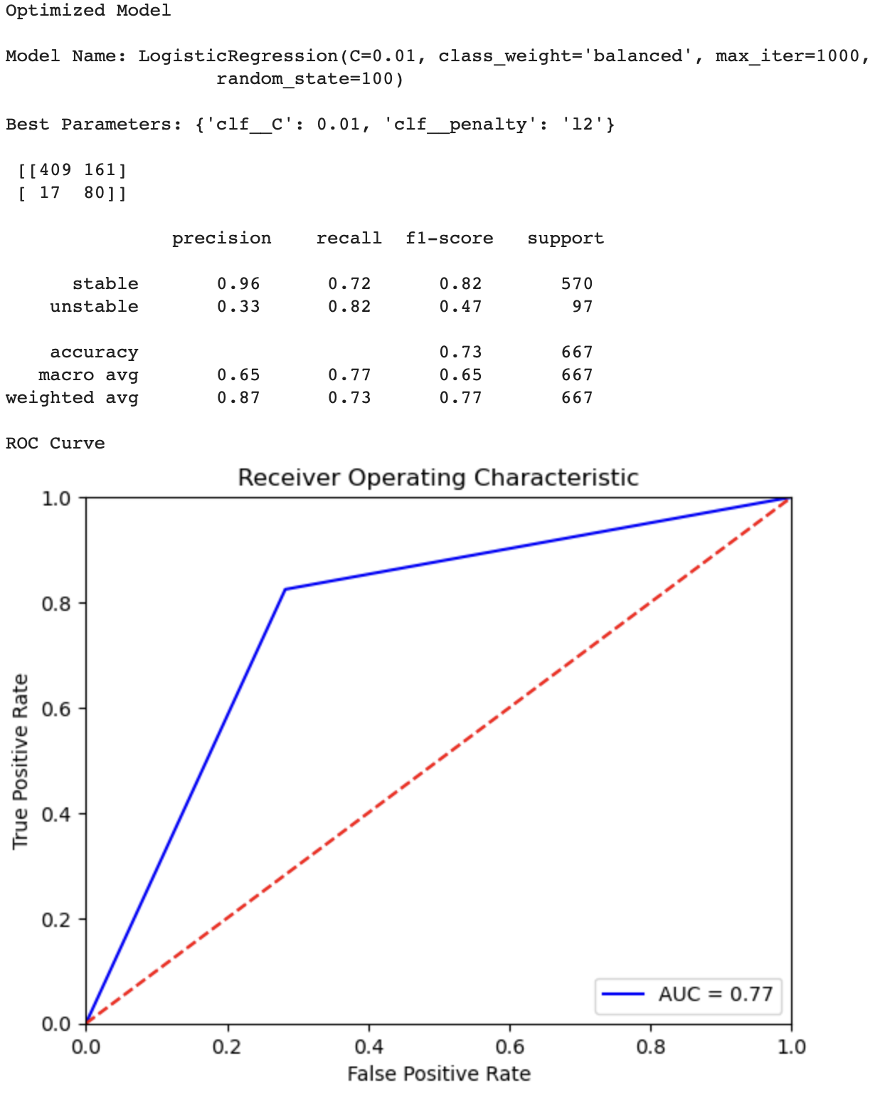
Logistical Regression Model
z

Slide 9
Logistical Regression Model continued….
Precision & Recall (Imbalance in Class Prediction):
Stable Class: The precision for predicting customers who are not likely to churn (stable) is very high at 0.96, indicating that when the model predicts a customer will not churn, it is correct 96% of the time. However, the recall for this class is 0.72, meaning the model correctly identifies 72% of the actual stable customers. This indicates that while the model is very precise for the stable class, it misses about 28% of them.
Unstable Class: The precision for predicting customers likely to churn (unstable) is low at 0.33, but the recall is higher at 0.82, indicating that the model is good at identifying actual churners (82% of them), but it also makes a significant number of false positive predictions.
F1-Score & Support (Overall Performance):
The F1-score, which balances precision and recall, is 0.82 for the stable class but only 0.47 for the unstable class. This imbalance shows that the model performs significantly better in predicting customers who won’t churn compared to those who will. The support values (570 for stable and 97 for unstable) indicate the distribution of the data, showing that the model had many more stable customers to learn from.
ROC/AUC (Model’s Discriminatory Power):
The AUC score is 0.77, which suggests that the model has a good but not excellent ability to distinguish between customers who will churn and those who will not. The ROC curve reflects this, showing a moderate ability to classify positive instances correctly.

Slide 10
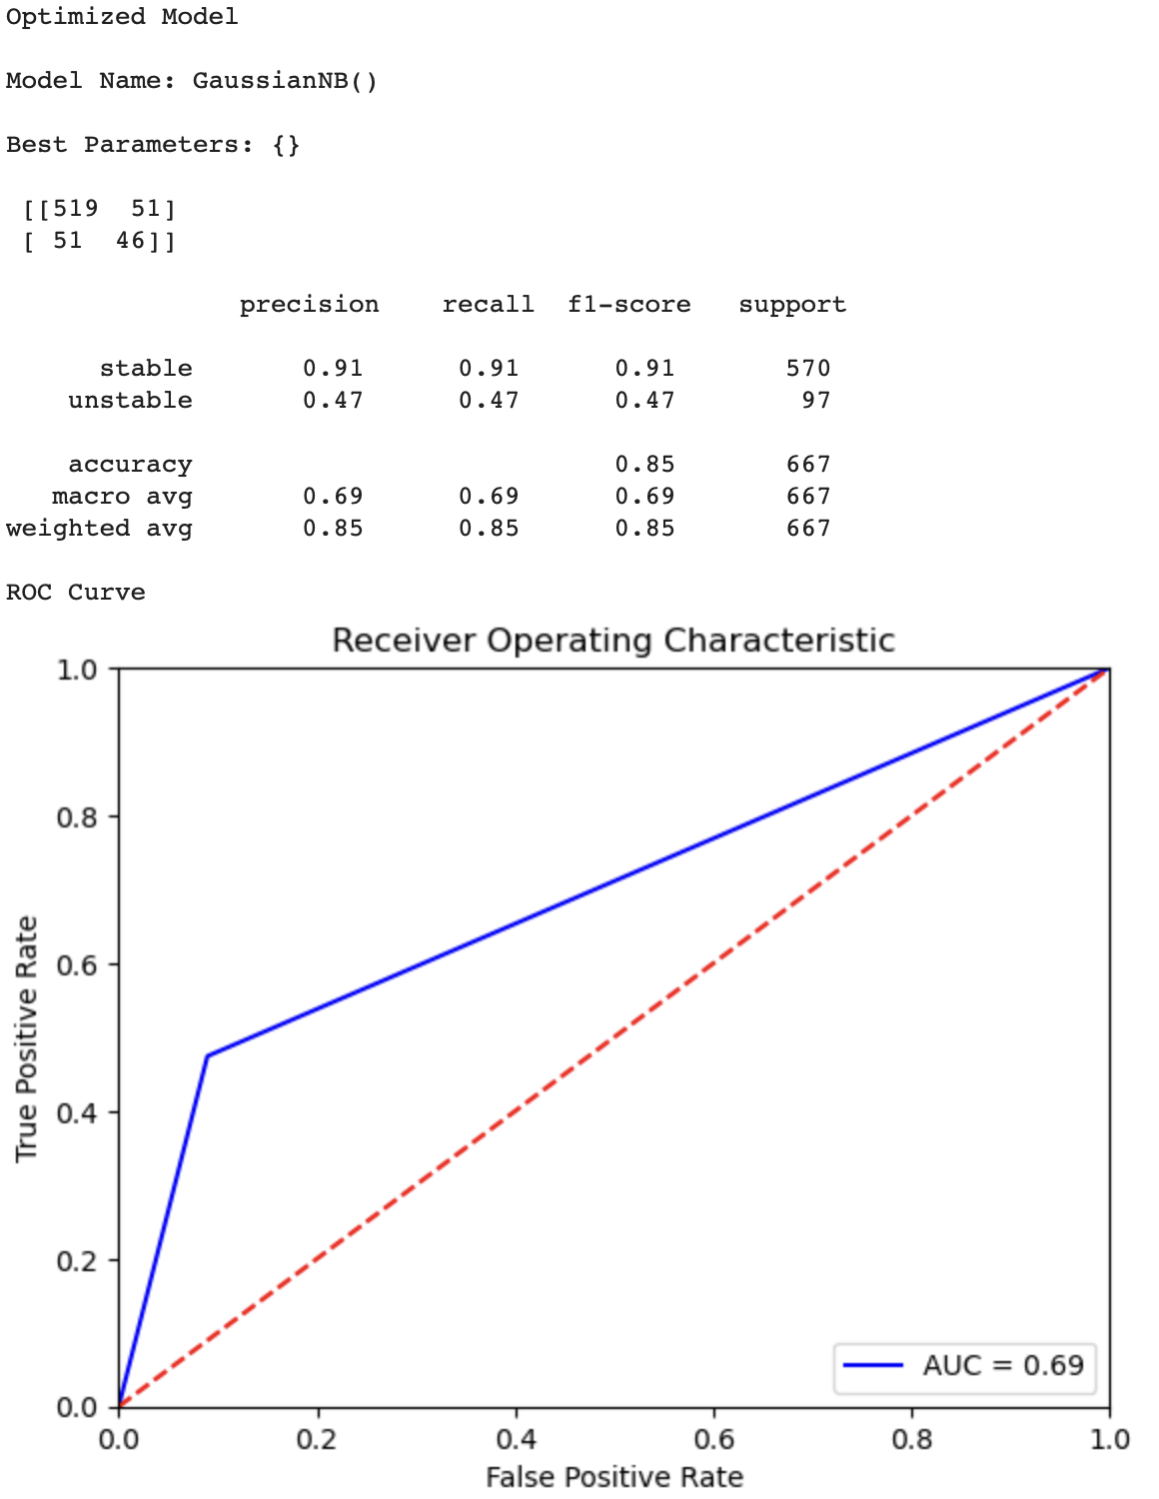
Gaussian Naïve Bayes Model
z

Slide 11
Gaussian Naïve Bayes Model continued….
Precision & Recall (Balanced vs. Unbalanced Prediction):
Stable Class: Both precision and recall for predicting stable customers are 0.91, indicating the model is highly accurate in predicting customers who are not likely to churn, with an excellent balance between precision and recall.
Unstable Class: For customers likely to churn, both precision and recall are much lower at 0.47. This indicates that the model struggles to accurately predict churners, with nearly half of the predictions for this class being incorrect.
F1-Score & Support (Overall Accuracy):
The F1-score mirrors the precision and recall metrics, showing a strong performance (0.91) for the stable class but a weaker performance (0.47) for the unstable class. This indicates that the GaussianNB model performs very well when predicting the majority class (stable) but poorly for the minority class (unstable). The support distribution is the same as in the logistic regression model, emphasizing the model's stronger performance on the more prevalent class.
ROC/AUC (Discriminatory Ability):
The AUC score is 0.69, which is lower than the logistic regression model, indicating that the Naïve Bayes model has less discriminatory power in distinguishing between churners and non-churners. The ROC curve reflects a less pronounced curve, indicating a lower true positive rate across various thresholds.

Slide 12
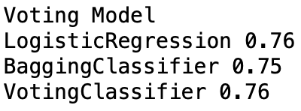
Ensemble Voting Model
The Voting Classifier combines multiple models (in this case, Logistic Regression and Bagging Classifier) to improve overall performance by aggregating their predictions. The final output is the class that receives the majority of votes from these models.

Slide 13
Comparison of Ensemble Voting Model with Logistic Regression and Naïve Bayes
Overall Accuracy
Voting Ensemble Model: The ensemble model achieved an accuracy score of 0.76, which is on par with the Logistic Regression model and slightly better than the Bagging Classifier (0.75).
Logistic Regression: Also scored 0.76, making it equally effective as the ensemble model in terms of overall accuracy.
Naïve Bayes: Scored 0.69, which is notably lower than both the Voting Ensemble and Logistic Regression models. This suggests that Naïve Bayes is less reliable in this context.

Slide 14
Comparison of Ensemble Voting Model with Logistic Regression and Naïve Bayes continued….
Model Robustness:
Voting Ensemble Model: The ensemble approach aggregates the strengths of multiple models, providing more robust predictions by reducing the risk associated with relying on a single model’s weaknesses. This makes it more reliable in varied situations.
Logistic Regression: While it performs well, it’s a single model and may not capture all the complexities in the data as effectively as an ensemble.
Naïve Bayes: Naïve Bayes makes strong assumptions about the independence of features, which can limit its effectiveness when these assumptions don’t hold true. It’s less robust compared to the Voting Ensemble.

Slide 15
Comparison of Ensemble Voting Model with Logistic Regression and Naïve Bayes continued….
Handling Class Imbalance:
Voting Ensemble Model: By combining predictions from different models, the ensemble can handle class imbalance better, as it balances the biases of individual models.
Logistic Regression: Tends to handle class imbalance well, especially when techniques like class weighting are applied, but it’s still just a single perspective.
Naïve Bayes: Often struggles with class imbalance because it assumes equal importance across features, leading to biased predictions towards the majority class.

Slide 16
Recommended Model for Implementation
Model: Voting Ensemble Model
Justification:
The Voting Ensemble model is recommended for implementation because it combines the strengths of multiple models, leading to more robust and stable predictions. It achieved a performance score of 0.76, matching the Logistic Regression model while benefiting from multiple classifiers' collective decision-making. This ensures that the model can handle various scenarios more effectively, particularly when compared to individual models like Naïve Bayes, which had lower accuracy.

Slide 17
Next Steps to Enhance Usability:
Feature Engineering: The model’s performance could be further enhanced by creating new features or transforming existing ones to capture better patterns related to customer churn. For example, creating interaction terms between variables like ‘DataUsage’ and ‘MonthlyCharge’ might reveal more nuanced relationships that improve model accuracy. Additionally, incorporating external data sources (e.g., customer satisfaction surveys or social media sentiment) could provide a more comprehensive view of customer behaviour, leading to better predictions.
Model Monitoring and Continuous Learning: To ensure the model remains accurate over time, it’s crucial to implement a system for monitoring its performance in real-world applications. This includes setting up regular evaluation cycles to check if the model’s predictions align with actual outcomes. If discrepancies are identified, the model can be retrained with new data. This continuous learning process helps maintain the model's relevance and accuracy as customer behaviours and market conditions evolve.

Slide 18
References
Tetikoglu, F. (2024).Week9e-Tutorial-IsoForest
Tetikoglu, F. (2024).Week5a-LDAQDA-lbfgs
Tetikoglu, F. (2024).Week4a-BayesKNN
Tetikoglu, F. (2024).Week3b-LogReg-lib
Tetikoglu, F. (2024). Week2 - Data2204-Overview-PandasProfiling [Lecture notes].

